Slide 1

Artificial Intelligence Programming Practice
Lecturer ： Rao Yunbo
University of Electronic Science and Technology of China ·
School of Information and Software Engineering
University of Electronic Science and Technology of China,
Chengdu, China , May 14, 2024

Slide 2
01
Faster-RCNN train process
01
Leaning object
02
Project implementation

Slide 3
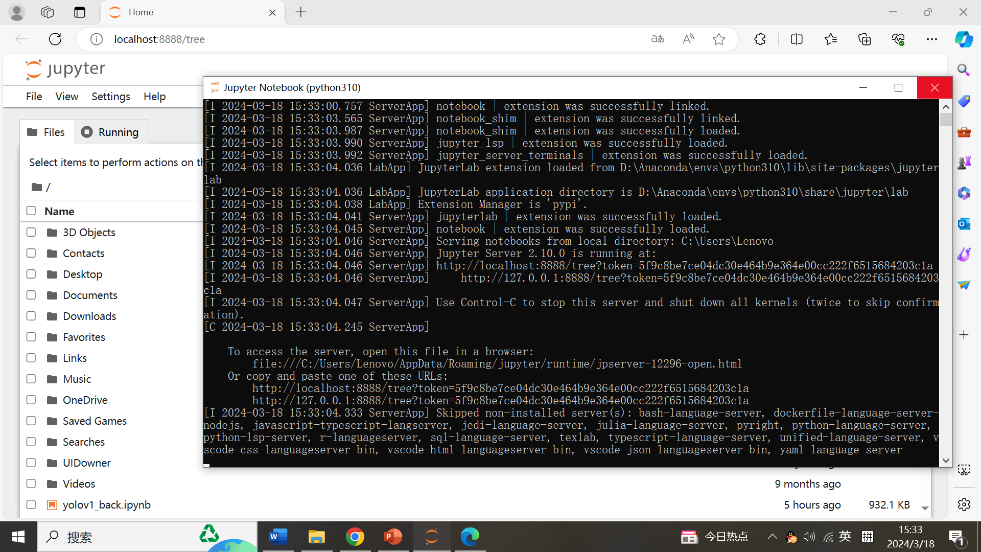
open：Jupyter notebook

Slide 4
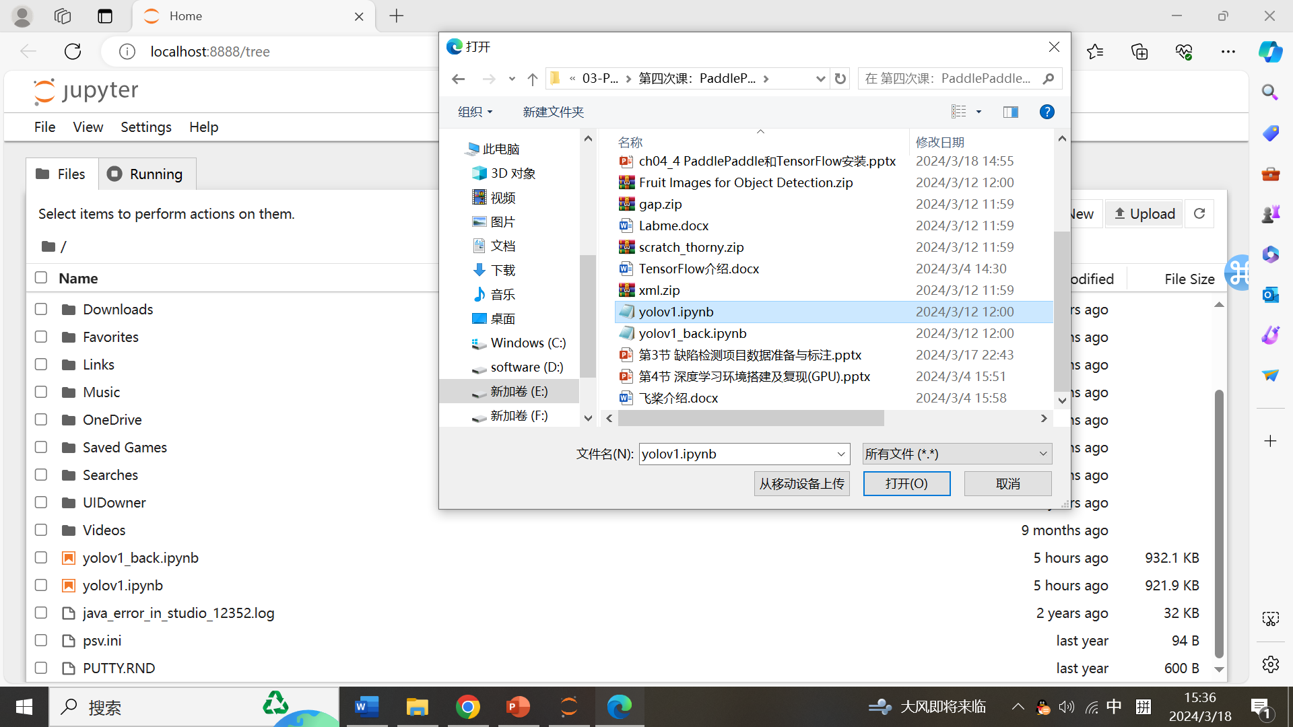

Slide 5
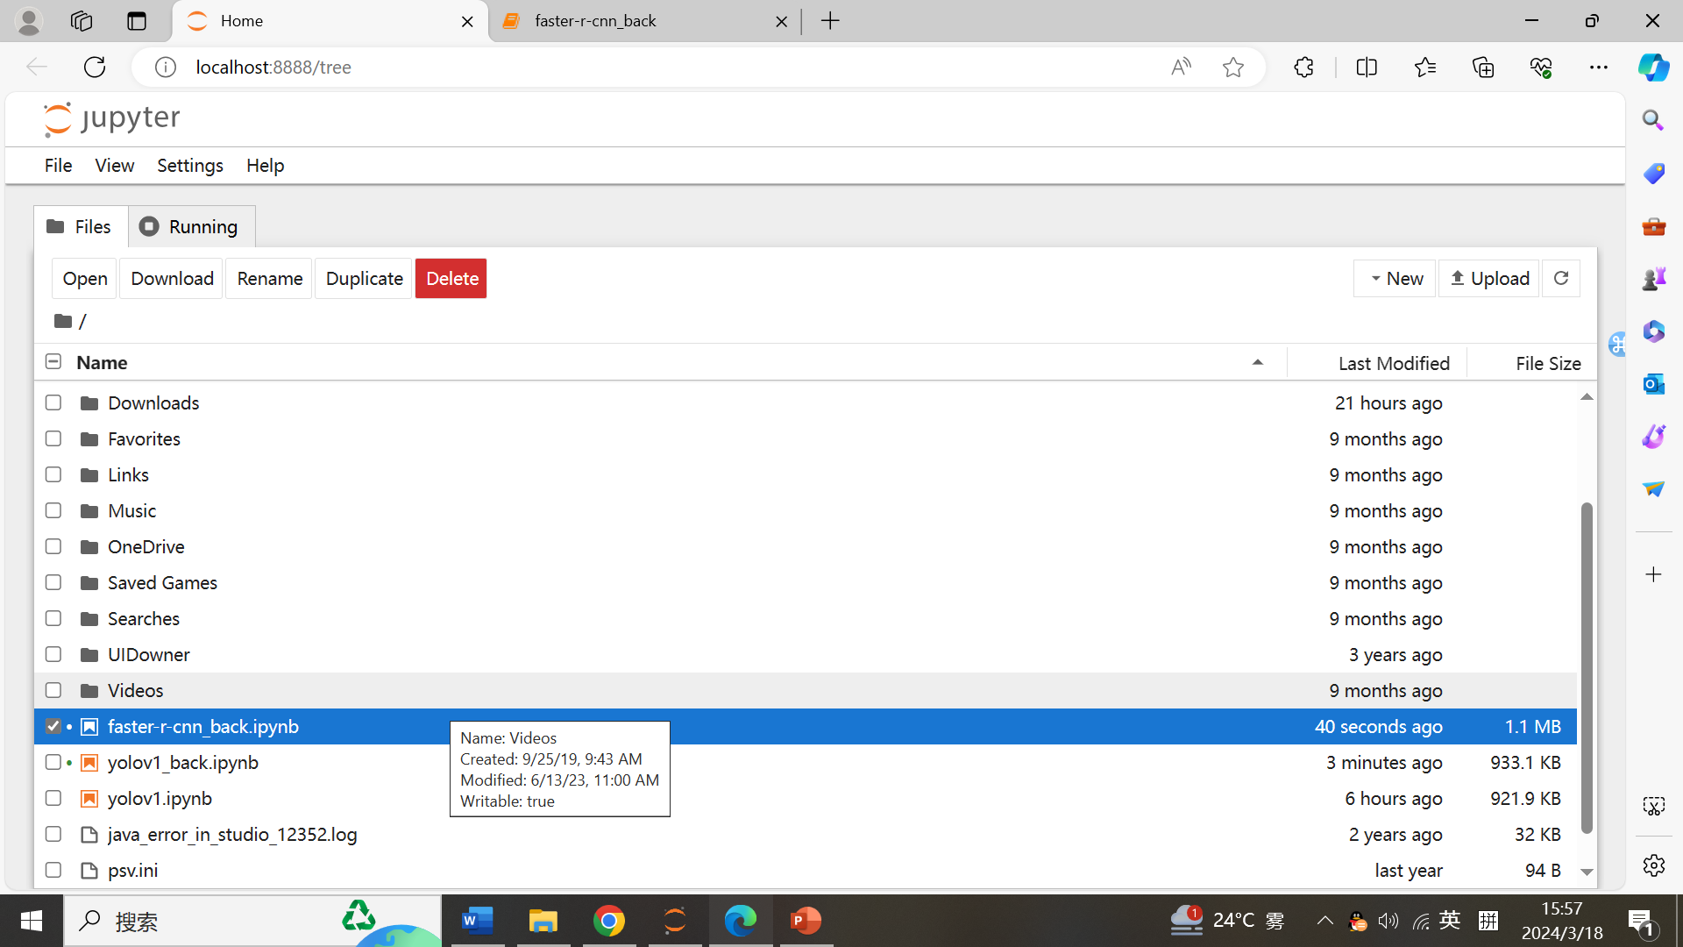
打开

Slide 6
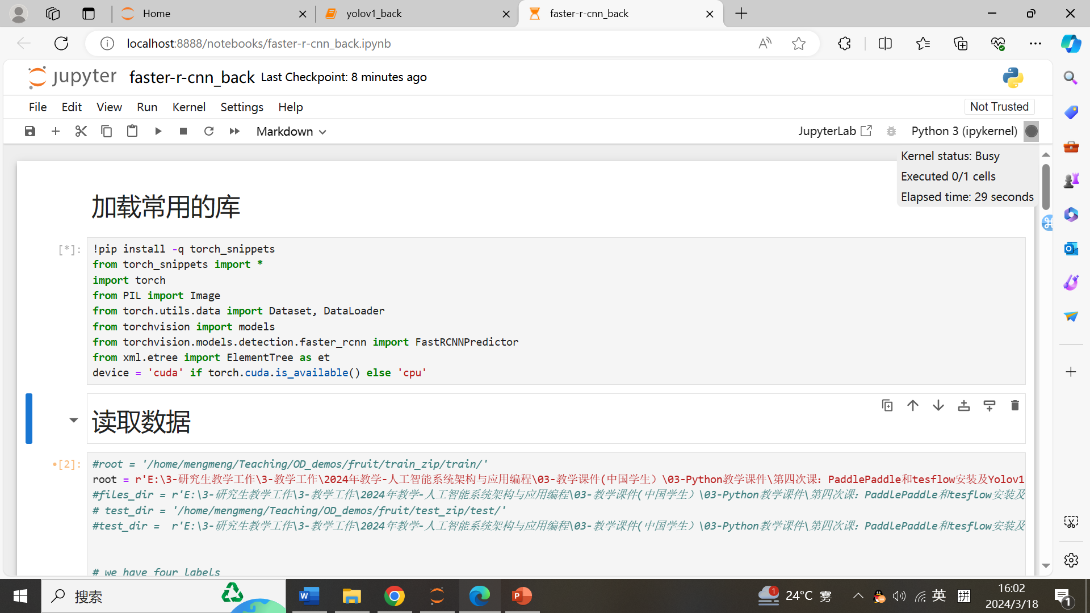
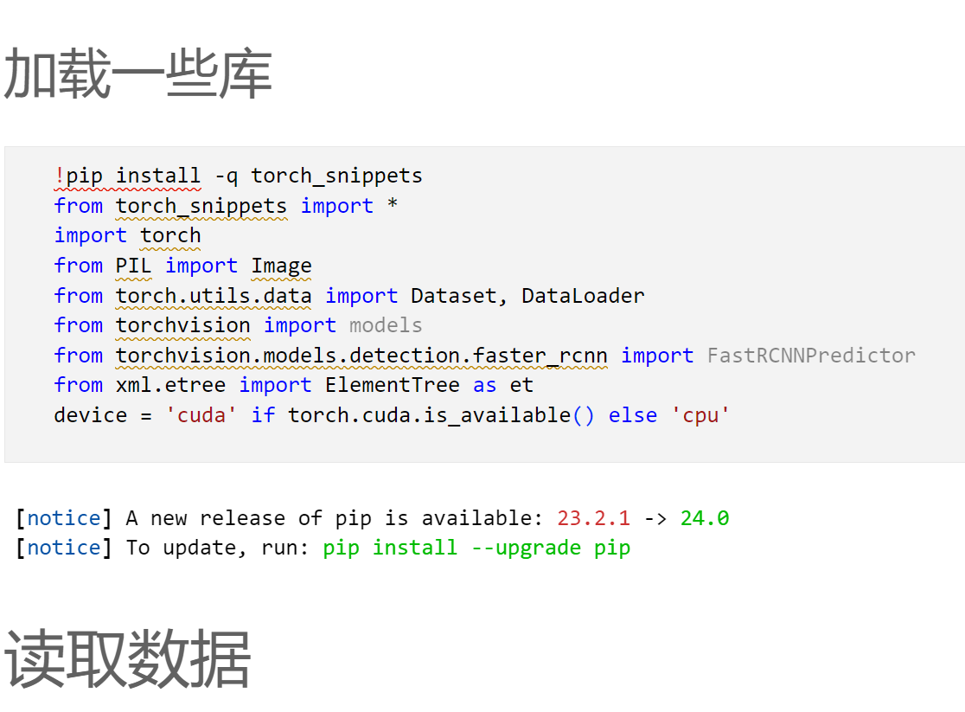
任务4：补完faster-rcnn
Run

Slide 7
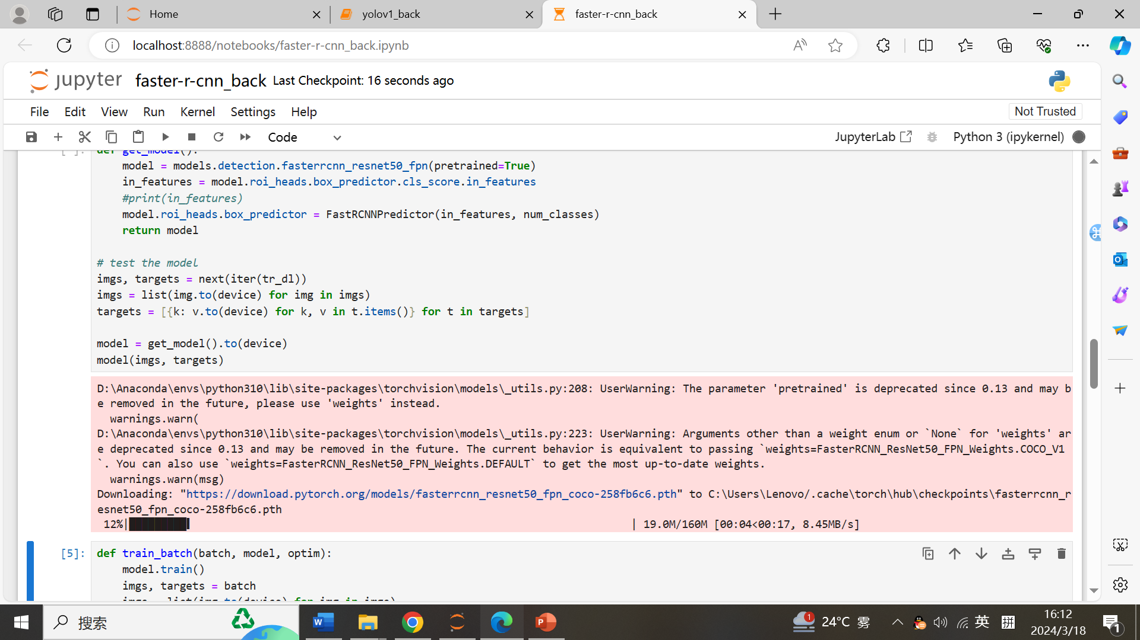
任务4：补完faster-rcnn
Download weight

Slide 8
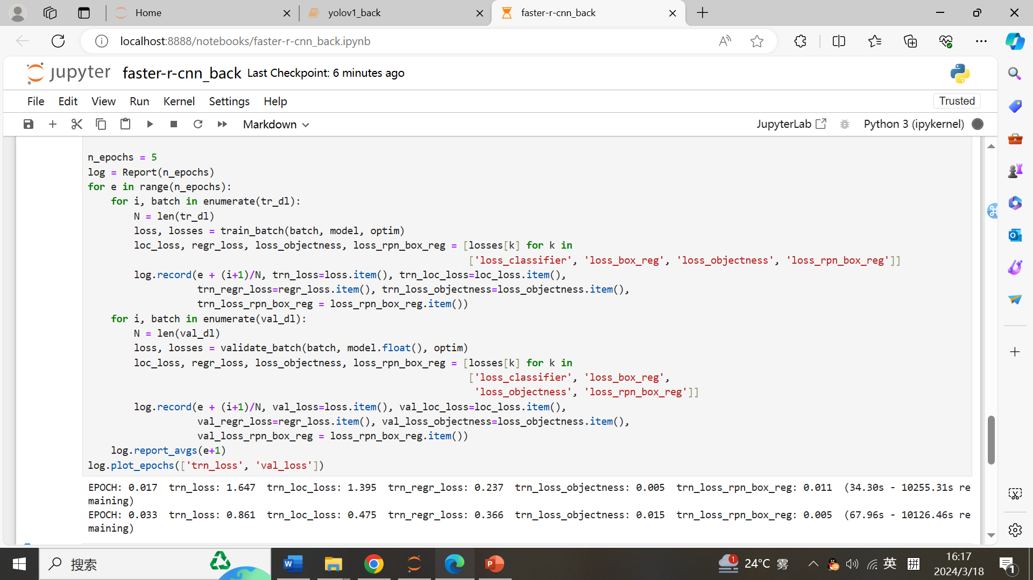
任务4：补完faster-rcnn

Slide 9
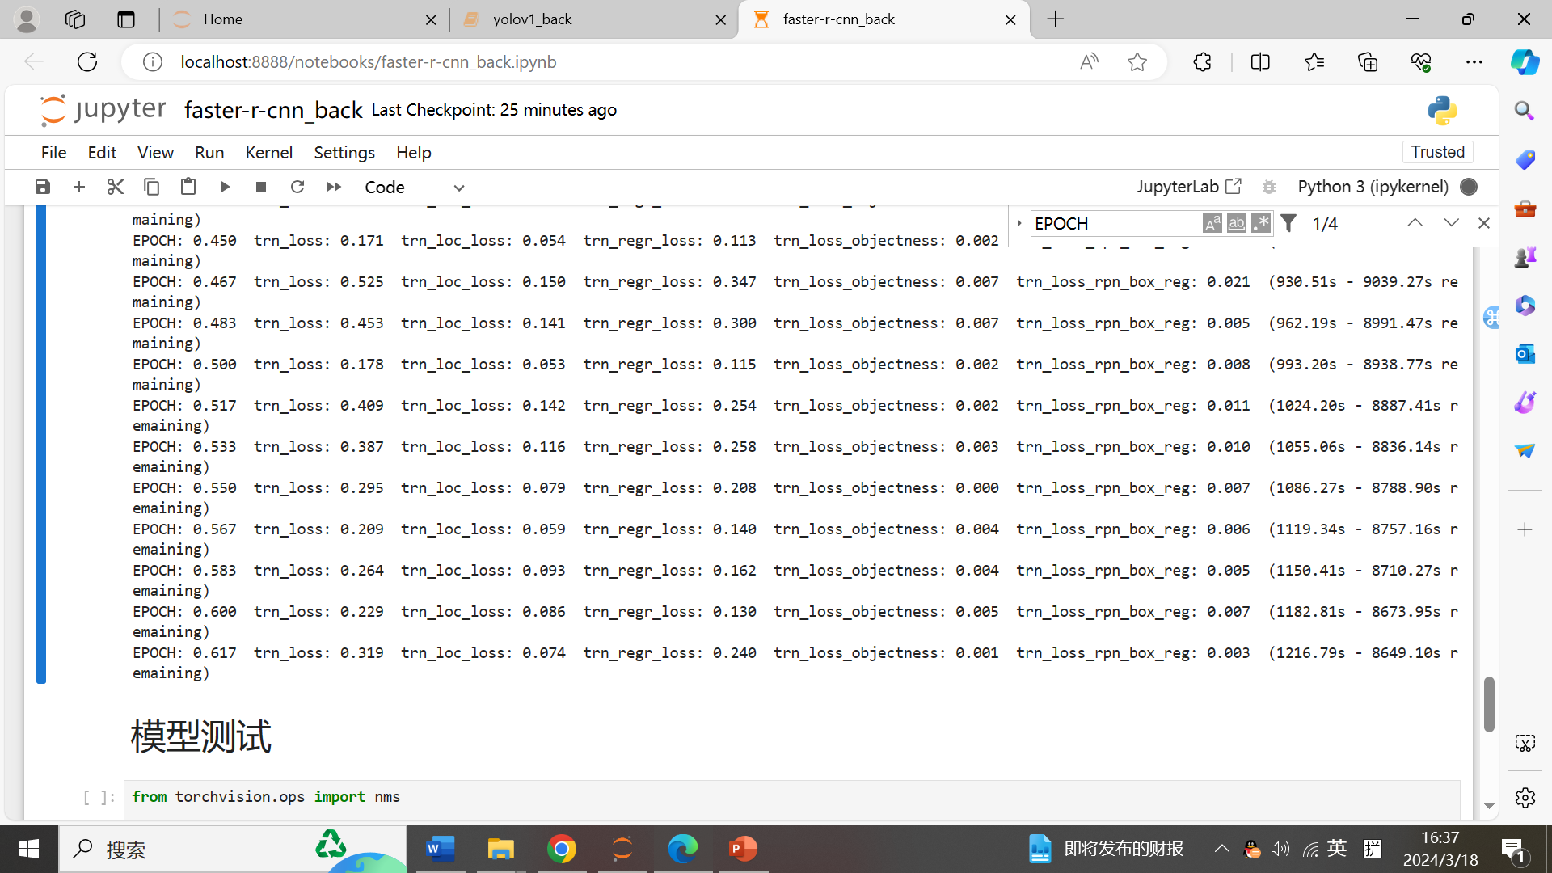

Slide 10
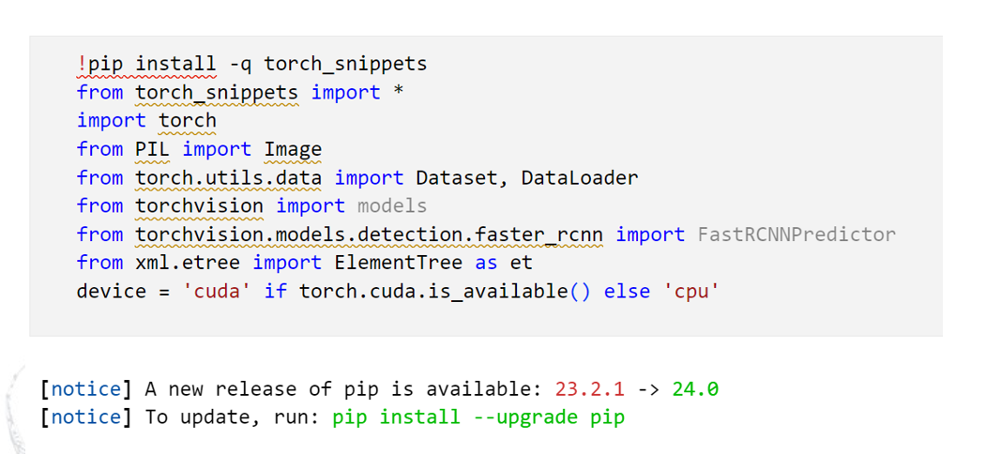
Task 4：finish faster-rcnn

Slide 11
Object detection：Faster-RCNN
Using PyCharm platform

Slide 12
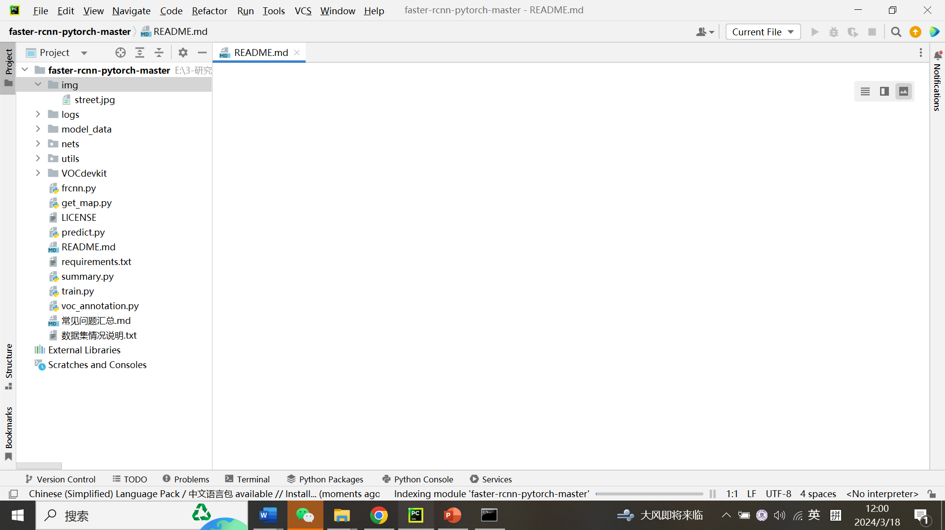
前言

Slide 13
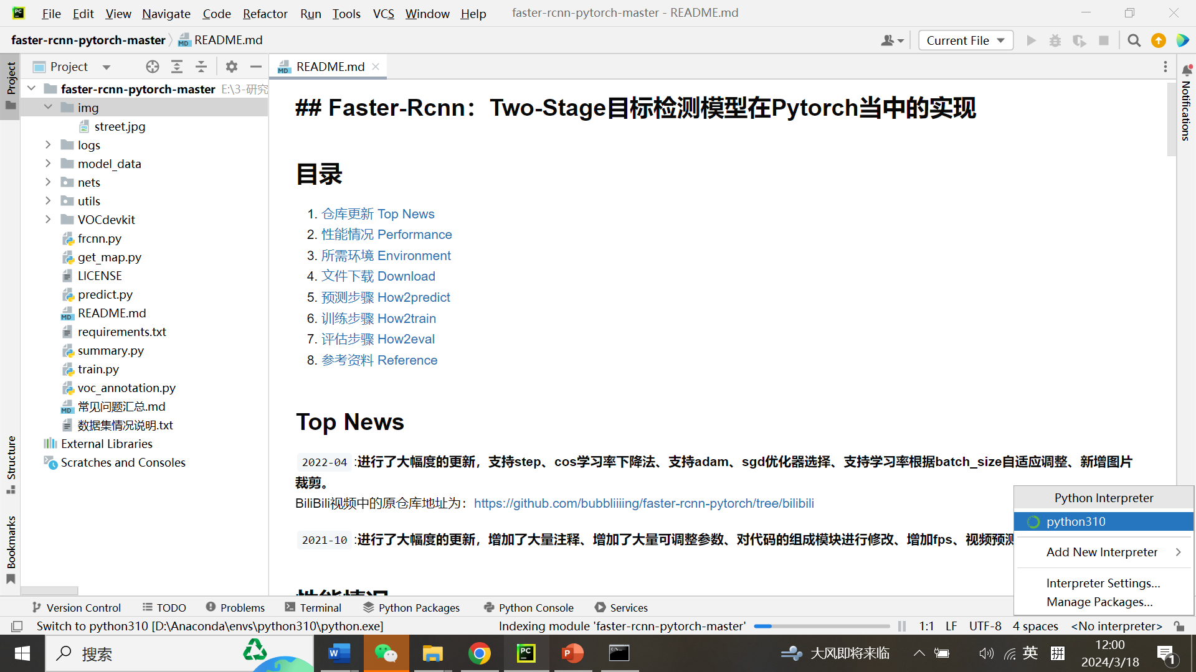
前言

Slide 14
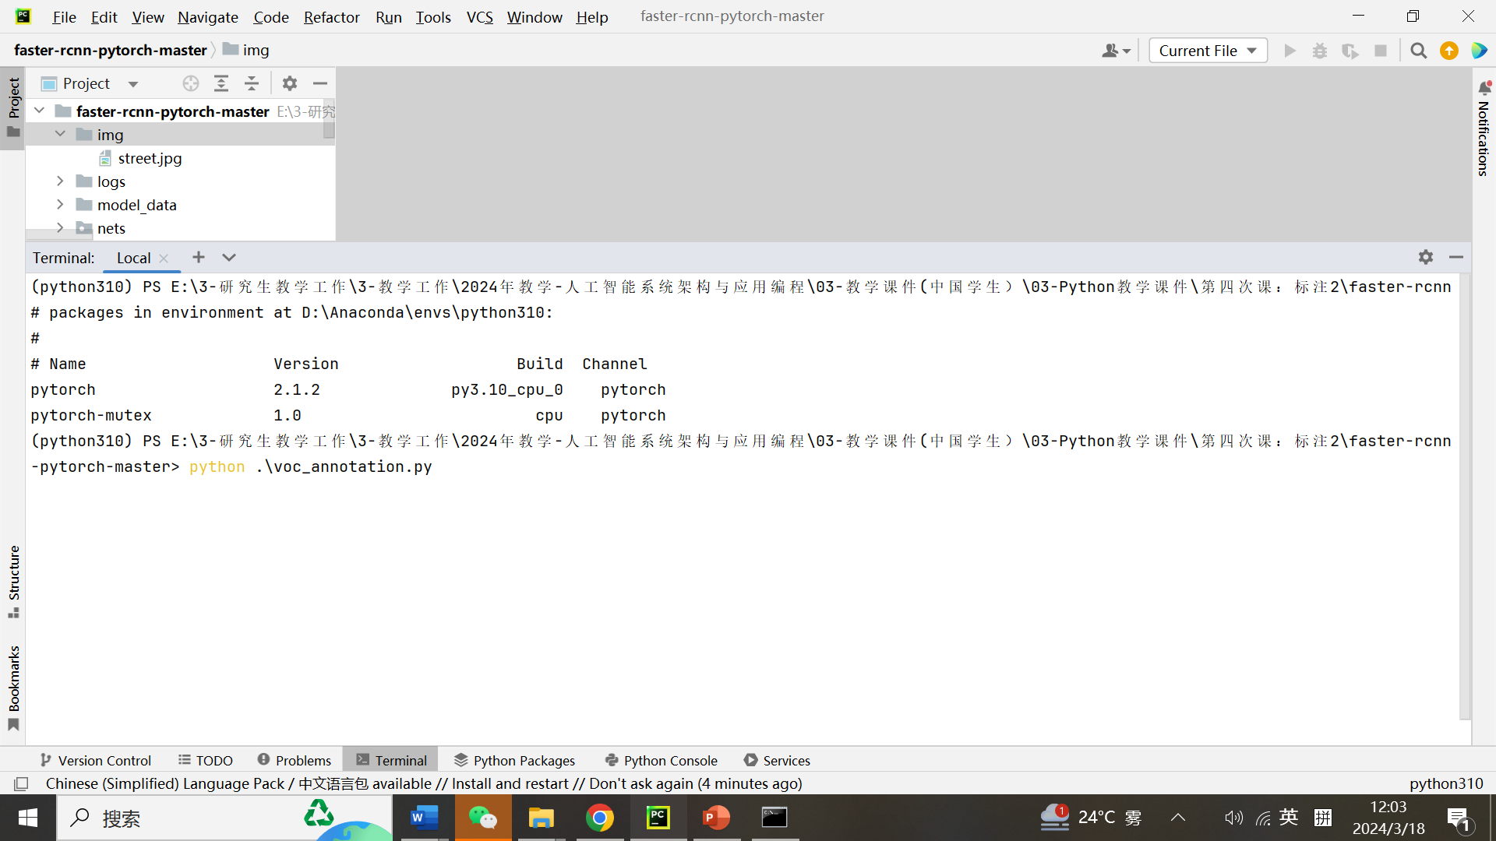
Run: voc_annotation.py dataset process script.

Slide 15
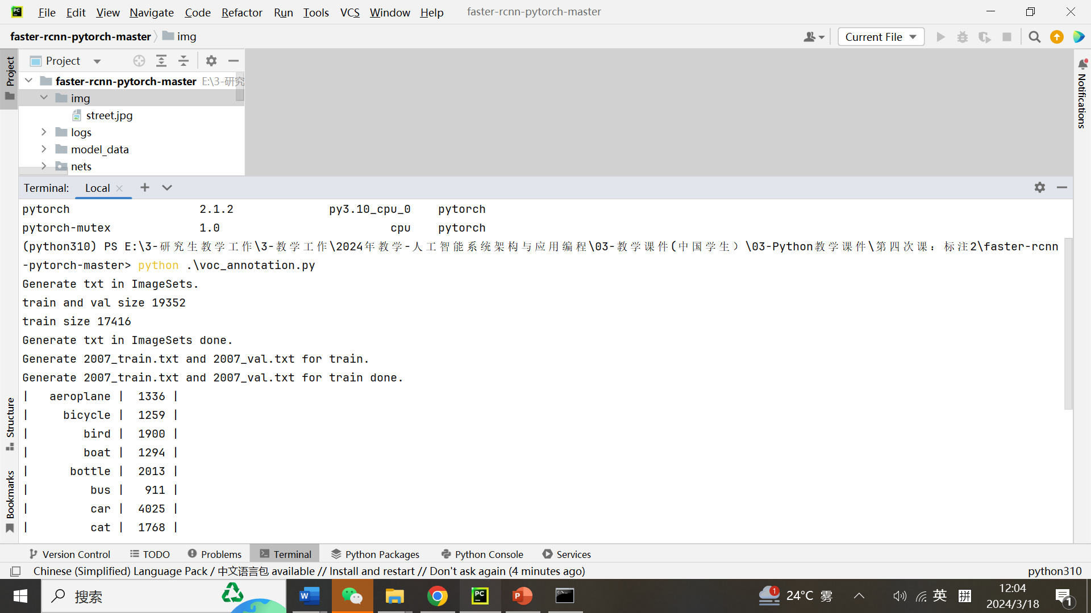
Run: voc_annotation.py dataset process script.

Slide 16
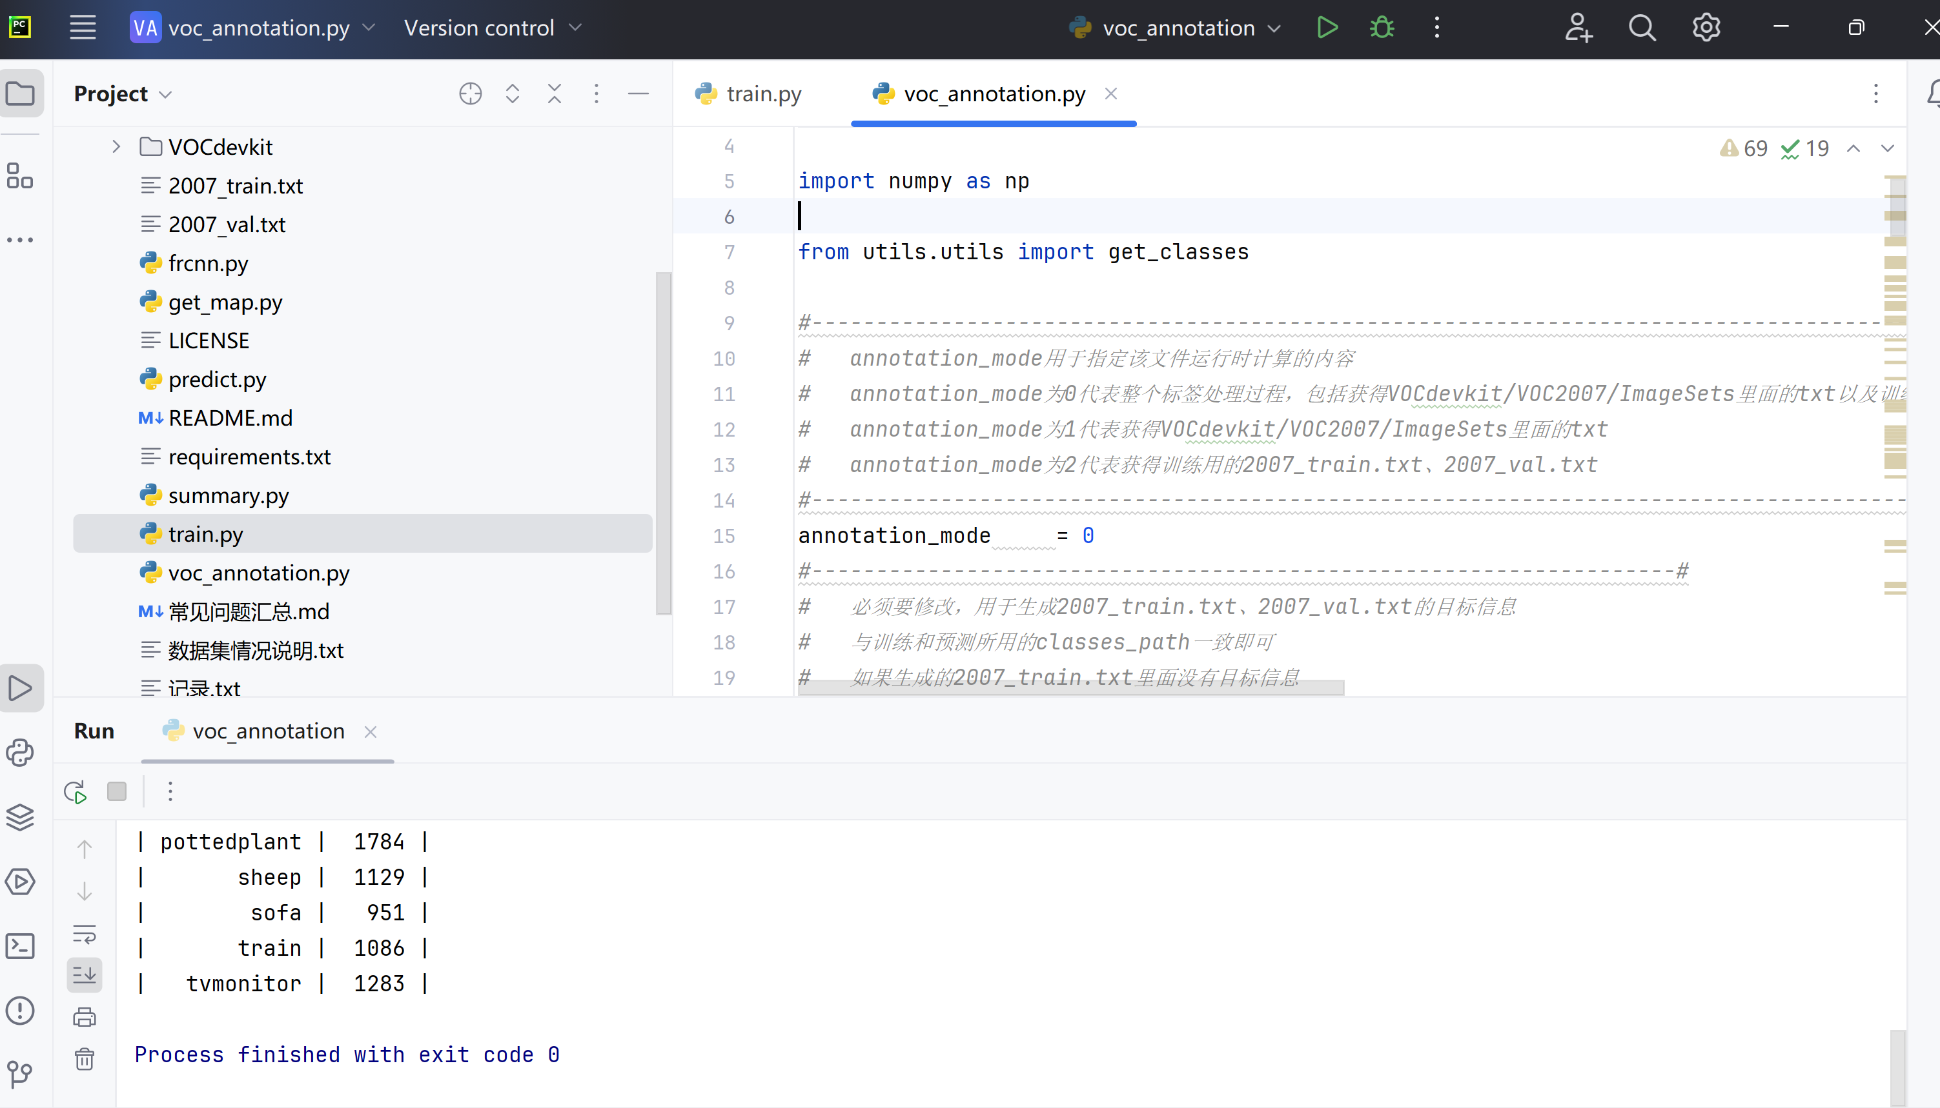
Run: voc_annotation.py dataset process script.

Slide 17
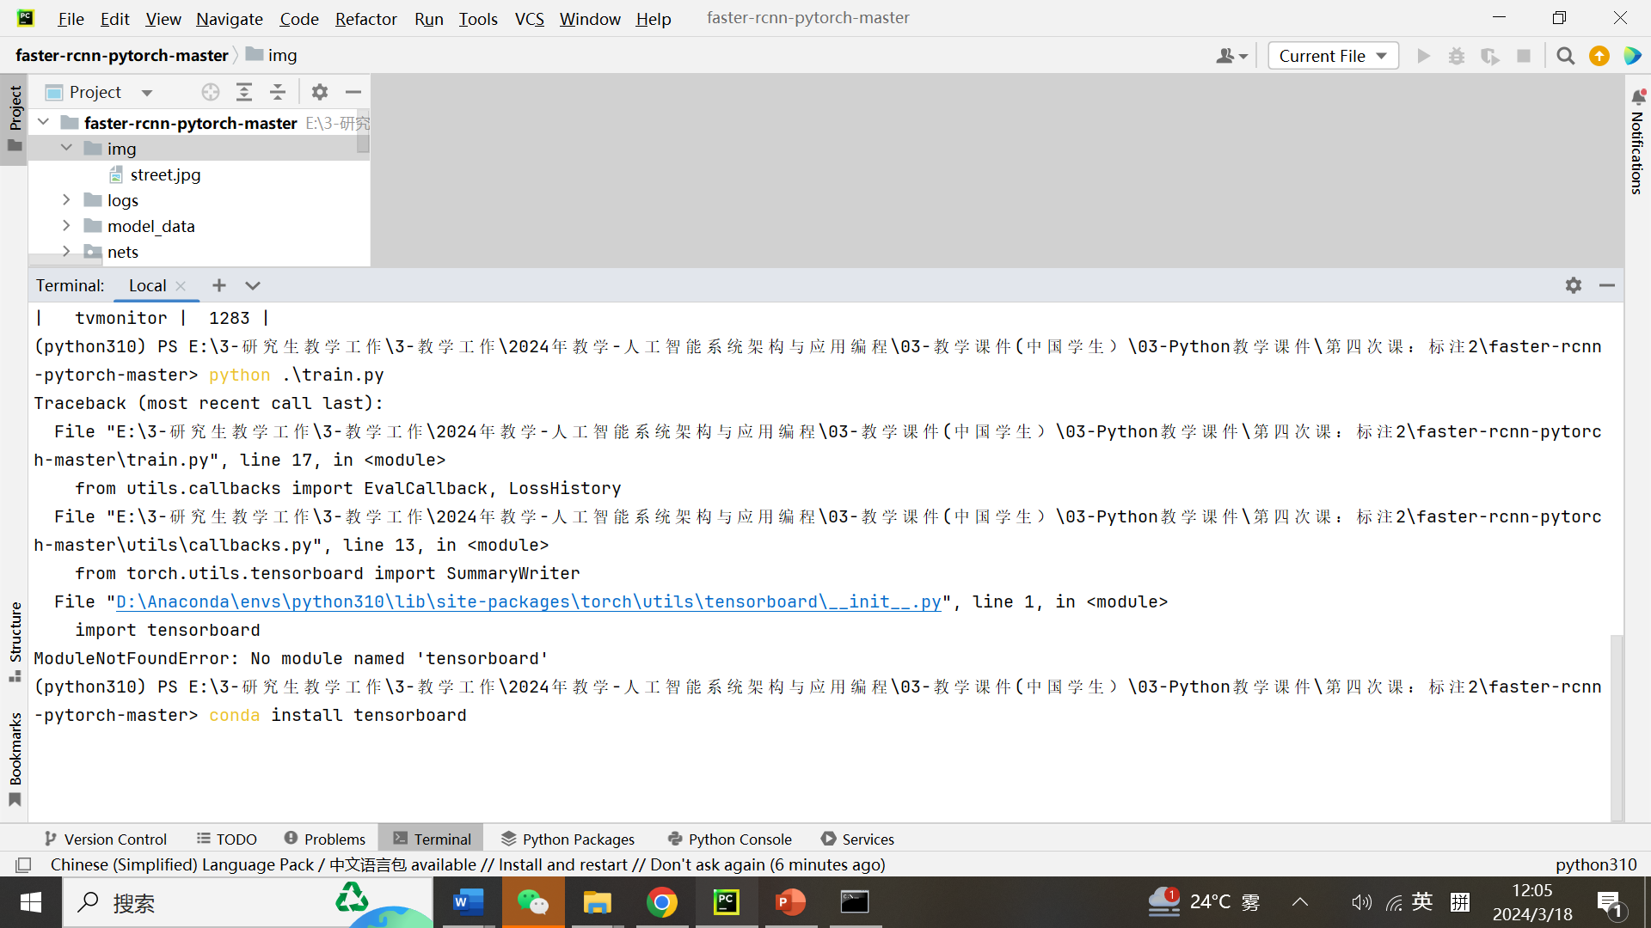
Install tensorboard

Slide 18
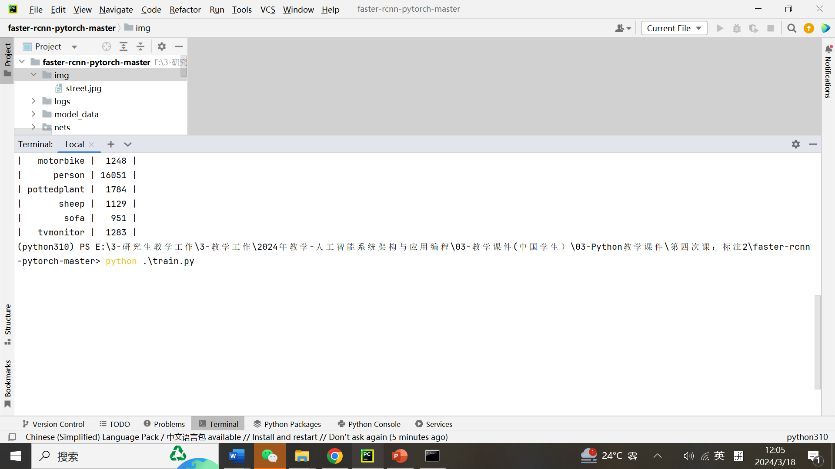
Run: train.py

Slide 19
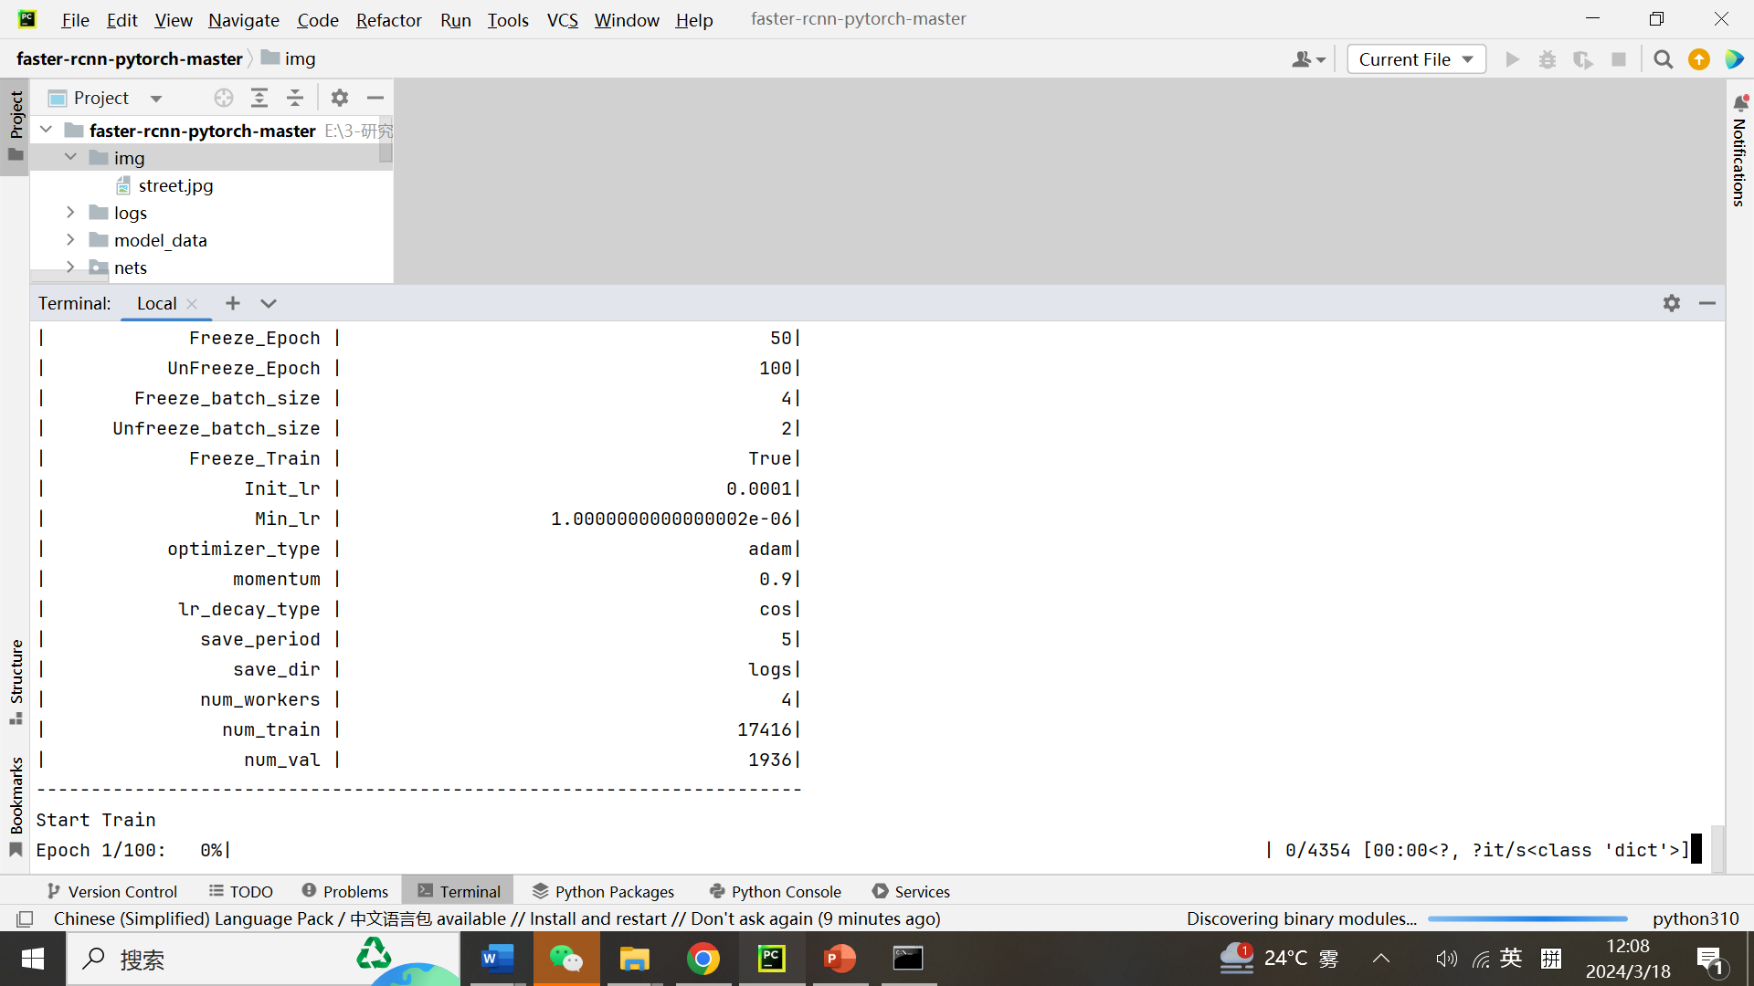
After train, get train information

Slide 20
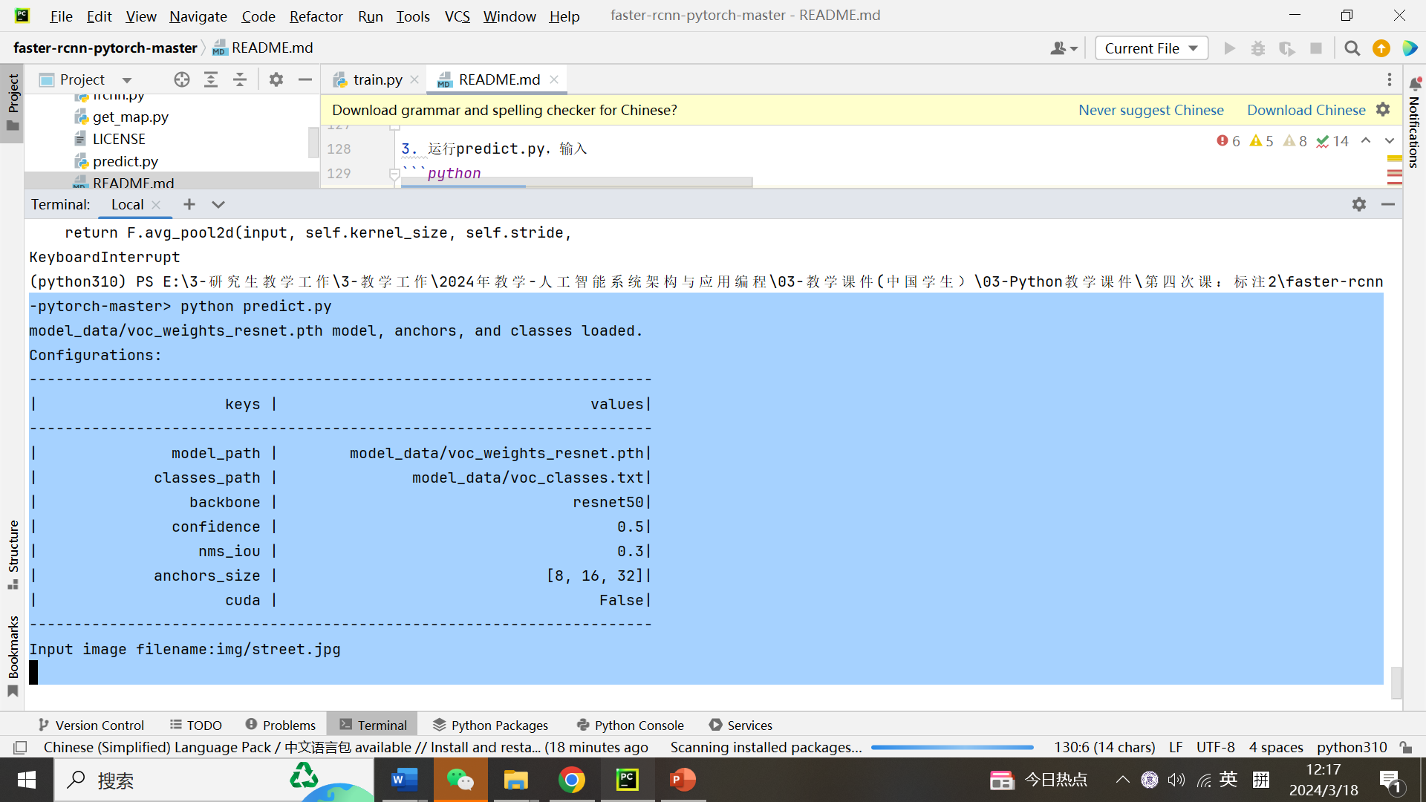
After predict.py, get information

Slide 21
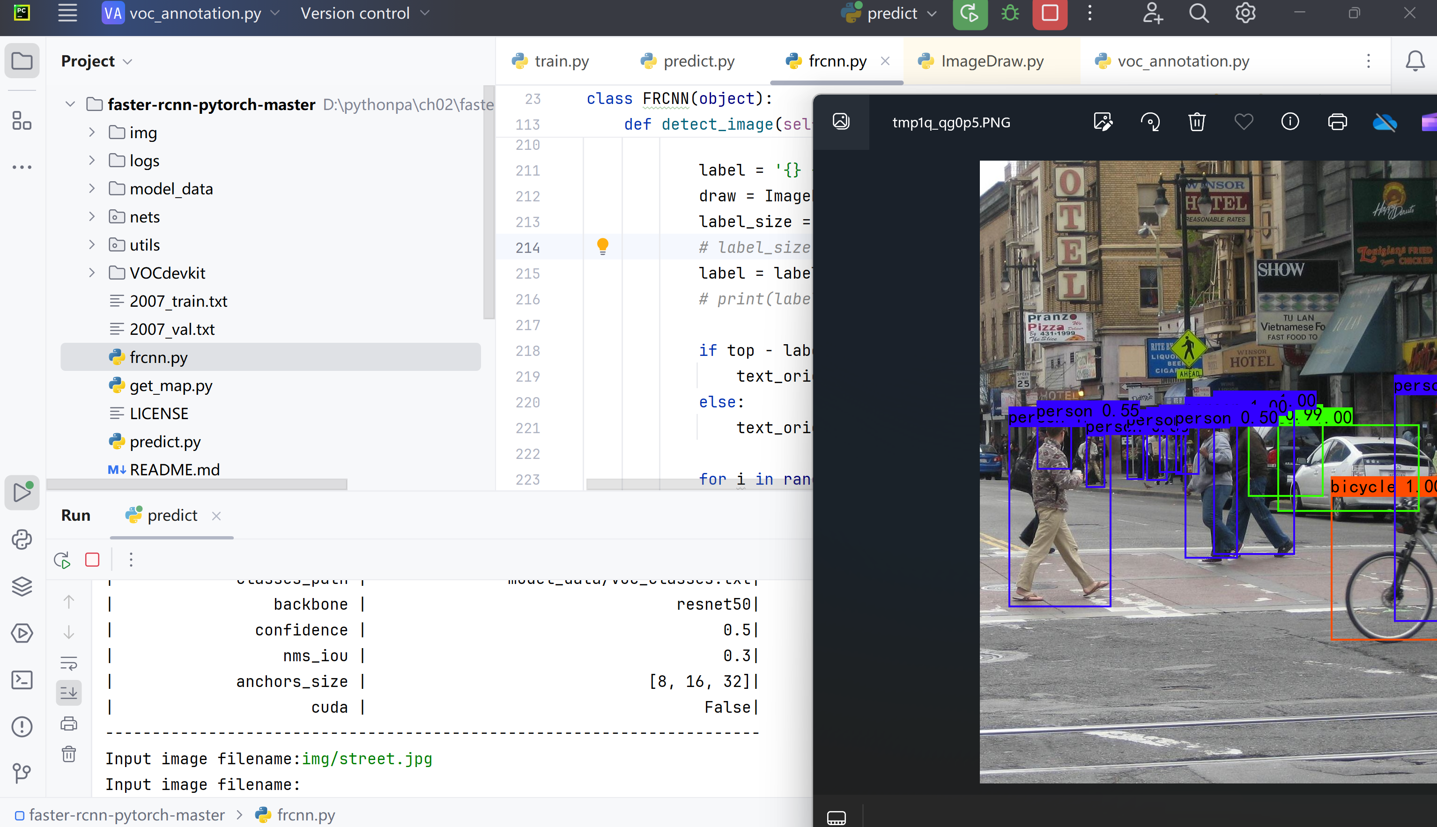
After predict.py, get information

Slide 22

谢谢！

